Slide 1
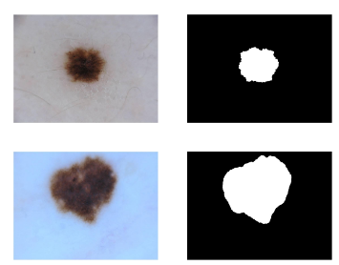
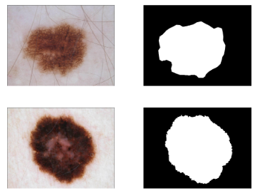
Dataset
Training:
2016 → 1052 images.
2017→ 1500 images.
2018→1886 images
Test:
2016 → 270 images
2017→ 650 images
2018→808 images
For testing we used separate test images. These test images were not seen by the model before.
We used 80% of the images from each dataset for training and the remaining 20% for validation.
Each dataset includes both the images and their corresponding masks.

Slide 2
Result for ISIC 2016-17-18 SAME NO CHANGE

Slide 3
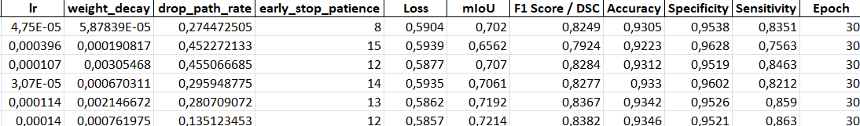
Hyperparameter Tuning

